Slide 1


Karthikeyan Anumalla
11-05-2025

Slide 2

Outline
Executive Summary
Introduction
Methodology
Results
Conclusion
Appendix

Slide 3
Executive Summary
Data collection from SpaceX API and performed Data cleaning on the collected data.
Performed web scraping to collect Falcon 9 historical launch records from a Wikipedia page
Performed EDA to find patterns in SpaceX Falcon 9 data, in order to choose the best Machine Learning model.
Operations on SpaceX Falcon dataset through Db2.
Analyzed Launch Site locations with the help of Folium
Developed a Machine Learning model to predict the “First stage landings”.
Overall Logistic-Regression is the best to predict the First Stage Landings

Slide 4
Introduction
The commercial space age is here; companies are making space travel affordable for everyone. Virgin Galactic is providing suborbital spaceflights. Rocket Lab is a small satellite provider. Blue Origin manufactures sub-orbital and orbital reusable rockets. Perhaps the most successful is SpaceX. SpaceX’s accomplishments include: Sending spacecraft to the International Space Station. Starlink, a satellite internet constellation providing satellite Internet access. Sending manned missions to Space.
The Main Goal of this project is to predict the cost of the launch of Falcon 9 rocket.
Most of the rockets require upwards of 165mil dollars for one single launch, where SpaceX Falcon 9 rocket requires 65mil dollars for one single launch. This is because of the first stage landing feature. If the rocket lands successfully then we can use the same rocket for another mission.
If we can determine if the first stage will land, then we can also determine the cost of the launch.

Slide 5

Section 1

Slide 6
Methodology
Executive Summary
Data collection methodology:
Data was collected from SpaceX API and Data Wrangling.
Perform data wrangling
Data wrangling was performed by calculating number of launched on each site, number of orbits, what are the outcomes pertaining to each orbit.
Perform exploratory data analysis (EDA) using visualization and SQL
Perform interactive visual analytics using Folium and Plotly Dash
Perform predictive analysis using classification models
We evaluated each Machine Learning model for Classification tasks, and with the help of GridSearchCV, performed hyperparameter tuning to get the best out of the chosen models.

Slide 7
Data Collection
Describe how data sets were collected.
Data was collected from SpaceX API and Web Scraping, where it was fetched from SpaceX API and normalized using pandas module, formatted to be in a single and structured format.
In Web Scraping, fetched the SpaceX Falcon 9 rocket data from wikipedia,.
Formatted the scraped data using Beautiful Soup and then extracted the feature names and the data needed for the problem to be solved.

Slide 8
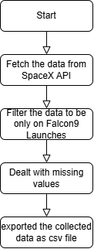
Data Collection – SpaceX API
Start -> Fetch Data from SpaceX API-> Filter the Data to be only on Falcon9 Launches-> Dealt with missing values-> exported the collected data as csv file.
Github URL: [LINK]

Slide 9
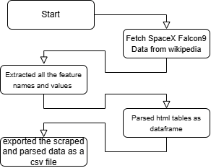
Data Collection - Scraping
Start -> Fetched SpaceX Falcon9 data from wikipedia -> Extracted all the feature names and values -> parsed html tables as dataframe -> exported the scraped and parsed data as csv file.
Github URL: [LINK]

Slide 10
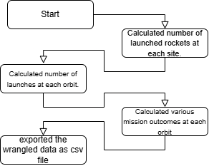
Data Wrangling
Missing values as handled in the previous labs.
Calculated various features like, number of launched rockets at each site, number of launches at each orbit, mission outcomes at each orbit.
Github URL: [LINK]

Slide 11
EDA with Data Visualization
Plotted the relationship between Flight Number and Launch Site, to know number of launches at each Launch Site
Plotted scatterplot to visualize the relationship between payload and launch site, which site has low payload mass missions, and which site has high payload mass missions.
Plotted bar graph to know the number of successful missions at each Orbit.
Plotted scatter plot to know the number of mission at each orbit using FlightNumber and Orbit.
Plotted scatter plot to know the distribution of payloadmass as each orbit. Where the rocket with high payload mass deployed at which orbit and vice versa.
Plotted line-graph to know the success rate of missions in year.
Github URL: [LINK]

Slide 12
EDA with SQL
Using SQL magic statements executed queries, pushed the data to database using Db2.
Fetched names of launch sites, launch sites beginning with ‘CCA’
Total and Average payload mass carried by boosters.
Date of first successful landing on ground pad.
Names of boosters which have successful landing on drone ship.
Total number of successful and failure missions.
Rank the count of landing outcomes (such as Failure (drone ship) or Success (ground pad)) between the date 2010-06-04 and 2017-03-20, in descending order
Github URL: [LINK]

Slide 13
Build an Interactive Map with Folium
Marked all the launch sites on map
Marked all the success and failed launches on each site on map.
Calculated distances between launch sites to its proximities.
These insights are to visualize the launch sites on the real world map.
Github URL: [LINK]

Slide 14
Build a Dashboard with Plotly Dash
Added a pie chart to visualize the success and fails at a launch site.
Added scatter plot to get the distribution of success and fails at a launch site.
Github URL: [LINK]

Slide 15
Predictive Analysis (Classification)
Evaluated the dataset, by splitting the dataset into train and test splits. Used various models for the classification task.
Used hyper parameter tuning to fine tune the model to its best performance on the train set.
Using train_test_split, split the data into train and test splits, 0.2 ratio, that is 20% test data, rest is train data. Then using GridSearchCV hyperparameter tuned all the classification models.
Github URL: [LINK]

Slide 16
Results
As payload increases the number of mission took place also decreases.
VAFB SLC 4E has least amount of launches but its success rate is very high. In this launch site there are not mission with above 10000 payload mass.
There is no successful mission at SO orbit.
From 2013 success rate kept increasing till 2020.
LogisticRegression is the best predictor with 83% accuracy on test data.

Slide 17
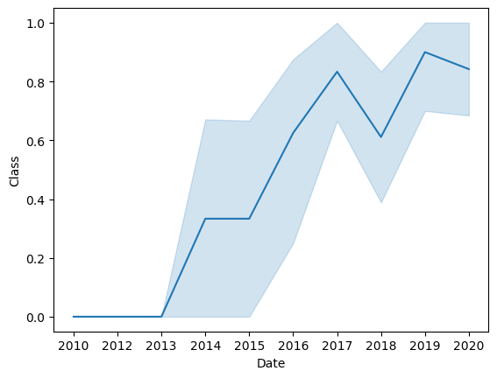
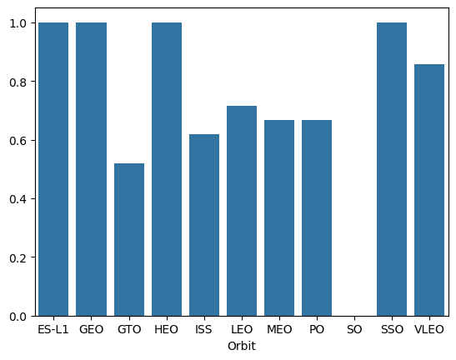

Slide 18

Section 2

Slide 19
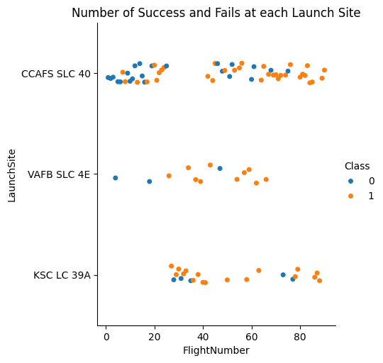
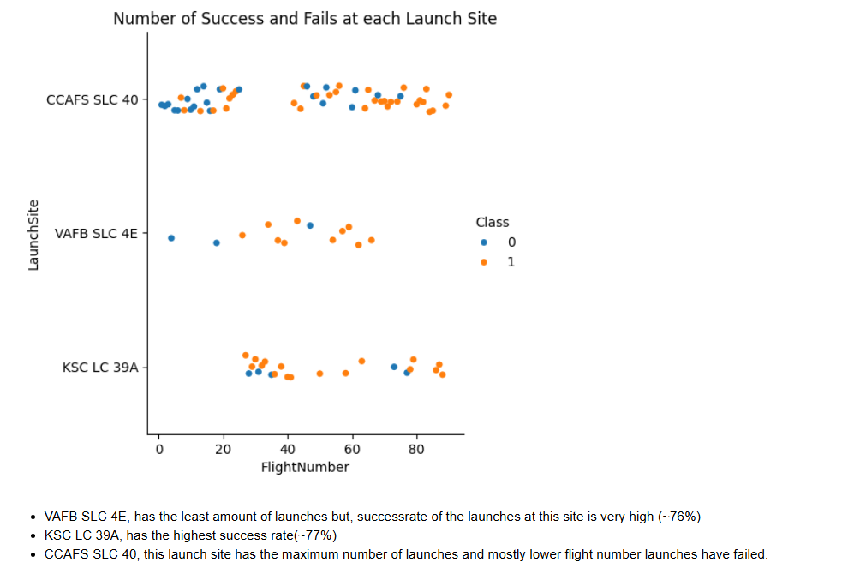
Flight Number vs. Launch Site
Show a scatter plot of Flight Number vs. Launch Site
Show the screenshot of the scatter plot with explanations

Slide 20
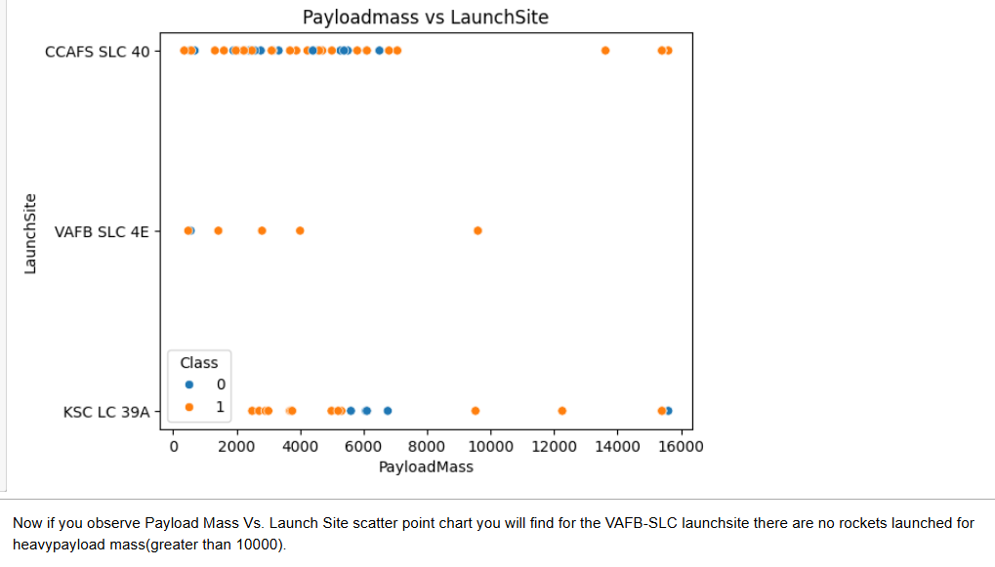
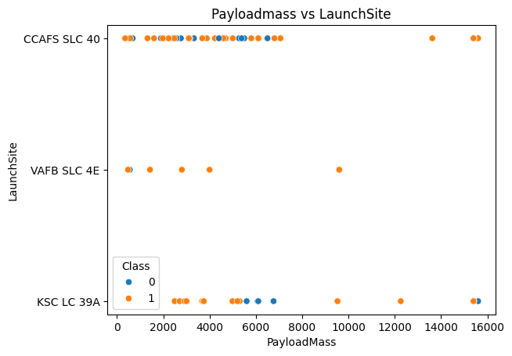
Payload vs. Launch Site
Show a scatter plot of Payload vs. Launch Site
Show the screenshot of the scatter plot with explanations

Slide 21
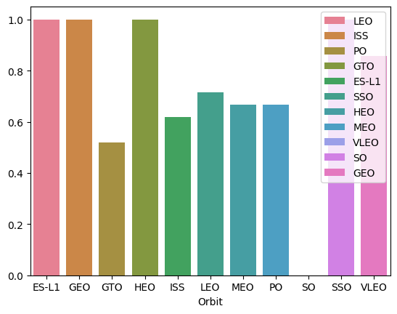
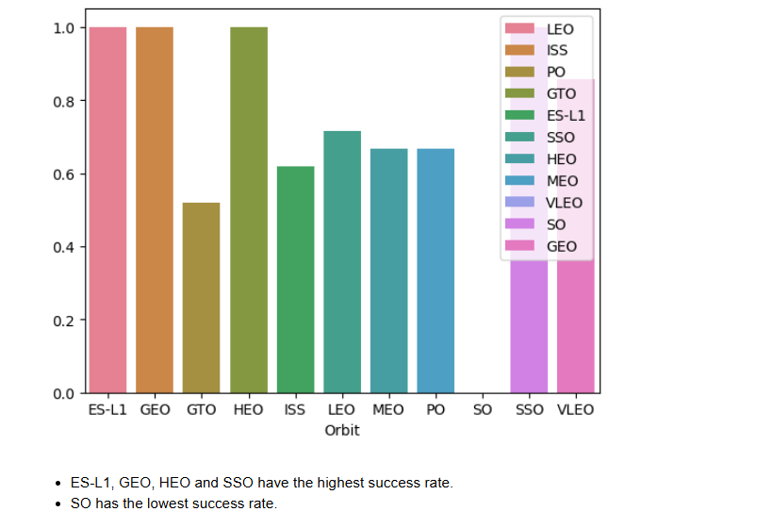
Success Rate vs. Orbit Type
Show a bar chart for the success rate of each orbit type
Show the screenshot of the scatter plot with explanations

Slide 22
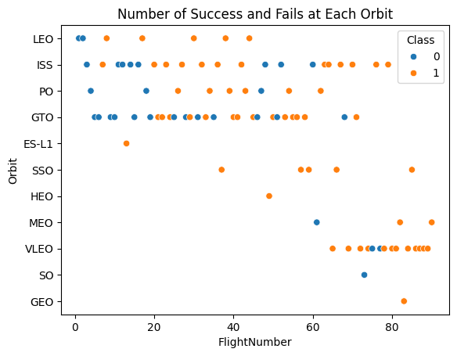
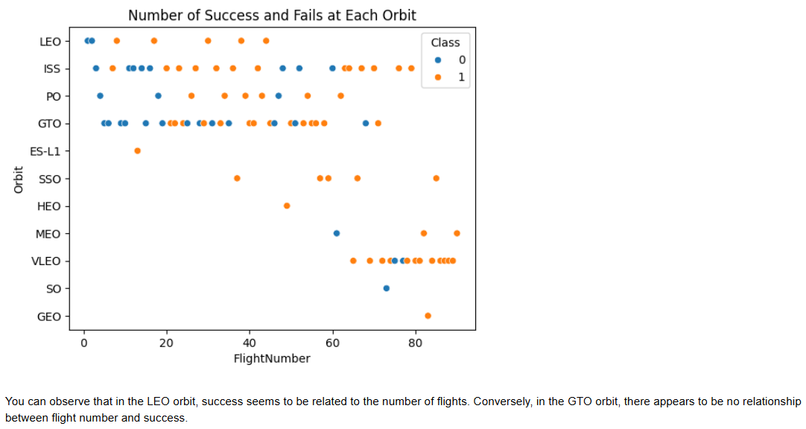
Flight Number vs. Orbit Type
Show a scatter point of Flight number vs. Orbit type
Show the screenshot of the scatter plot with explanations

Slide 23
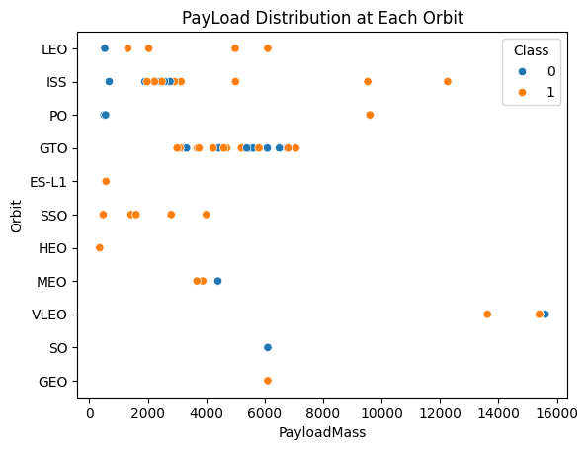
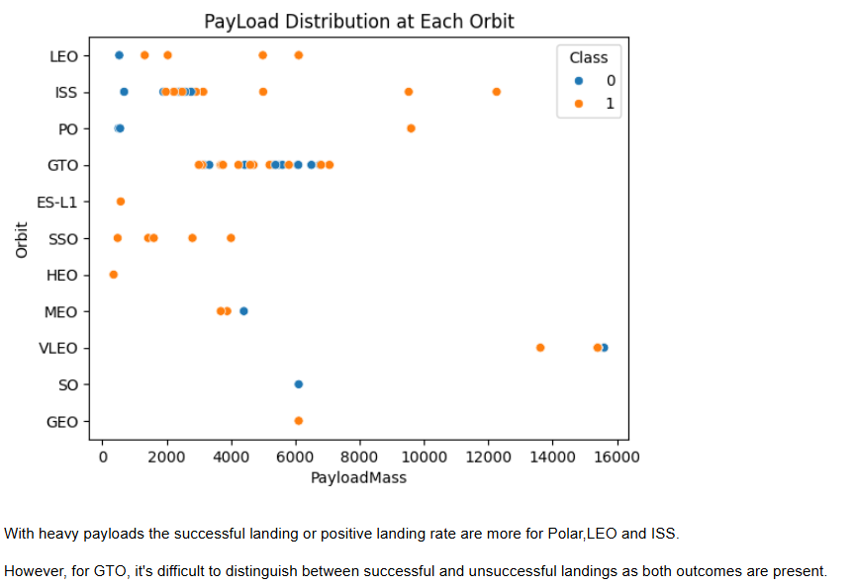
Payload vs. Orbit Type
Show a scatter point of payload vs. orbit type
Show the screenshot of the scatter plot with explanations

Slide 24
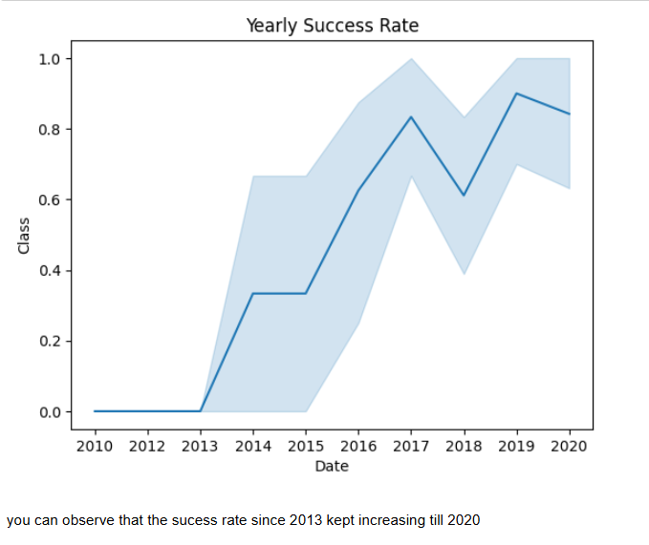
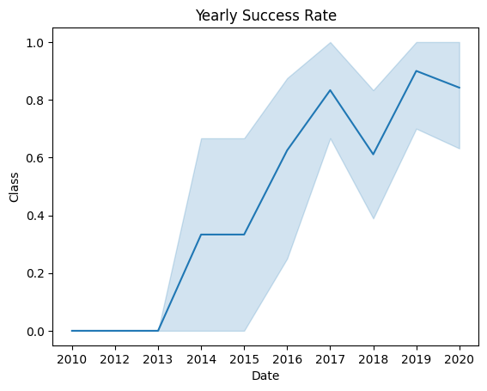
Launch Success Yearly Trend
Show a line chart of yearly average success rate
Show the screenshot of the scatter plot with explanations

Slide 25
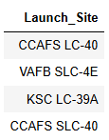
All Launch Site Names
%sql select distinct("Launch_Site") from SPACEXTABLE
This fetches the unique Launch Site names from SPACEXTABLE

Slide 26
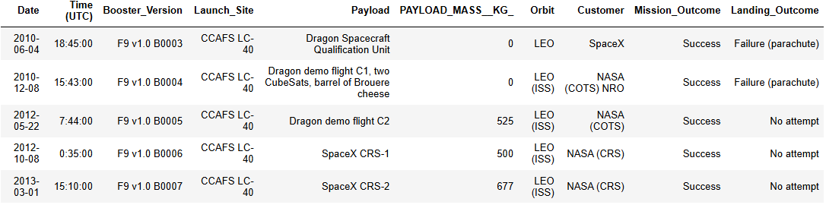
Launch Site Names Begin with 'CCA'
%sql select * from SPACEXTABLE where "Launch_Site" LIKE 'CCA%' limit 5

Slide 27
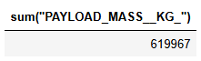
Total Payload Mass
%sql select sum("PAYLOAD_MASS__KG_") from SPACEXTABLE
so, in total the Payload carried by boosters is 619967 Kgs

Slide 28
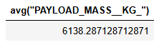
Average Payload Mass by F9 v1.1
%sql select avg("PAYLOAD_MASS__KG_") from SPACEXTABLE
Average Payload carried by boosters.

Slide 29
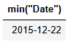
First Successful Ground Landing Date
%sql select min("Date") from SPACEXTABLE where "Landing_Outcome" == "Success (ground pad)";

Slide 30
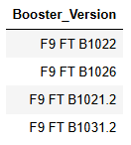
Successful Drone Ship Landing with Payload between 4000 and 6000
%sql Select Booster_Version from SPACEXTABLE where Landing_Outcome == "Success (drone ship)" and "PAYLOAD_MASS__KG_" between 4000 and 6000

Slide 31
Total Number of Successful and Failure Mission Outcomes
%sql select count("Mission_Outcome"), (Select count("Mission_Outcome") from SPACEXTABLE where "Mission_Outcome" like '%Failure%') from SPACEXTABLE where "Mission_Outcome" == 'Success'

Slide 32
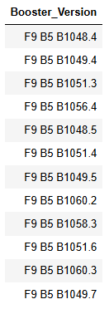
Boosters Carried Maximum Payload
%sql select Booster_Version from SPACEXTABLE where "PAYLOAD_MASS__KG_" = (Select max("PAYLOAD_MASS__KG_") from SPACEXTABLE)

Slide 33
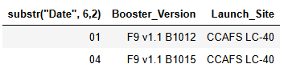
2015 Launch Records
%sql select substr("Date", 6,2) , "Booster_Version", "Launch_Site" from SPACEXTABLE where substr("Date", 0, 5) == '2015' and Landing_Outcome == 'Failure (drone ship)'

Slide 34
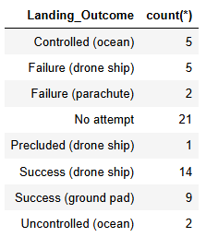
Rank Landing Outcomes Between 2010-06-04 and 2017-03-20
%sql select "Landing_Outcome", count(*) from SPACEXTABLE group by "Landing_Outcome" having "Date" between "2010-06-04" and "2017-03-20"

Slide 35

Section 3

Slide 36

Map with Launch Sites
VAFB SLC 4E launch site is near Los Angeles in the West Coast, other two are in the East Coast.

Slide 37
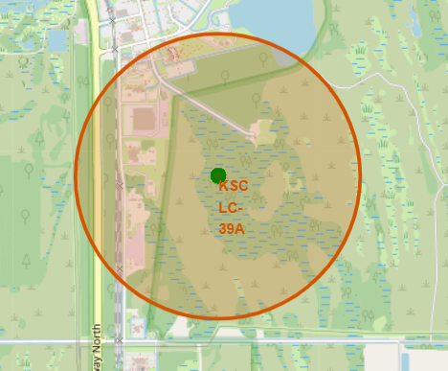
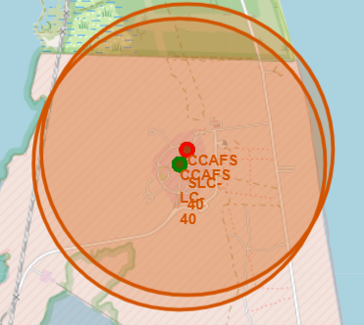
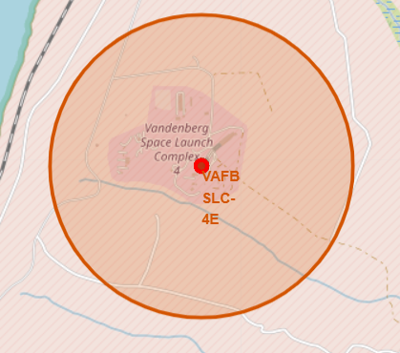
Success and Failure Rates of Launch Sites
KSC LC-39A and CCAFS SLC-40 are in the Each coast.
VAFB SLC-4E is very close to the West coast.

Slide 38

Launch Sites and their Proximities
Proximities are like Railways, Coastlines, etc.

Slide 39

Section 4

Slide 40
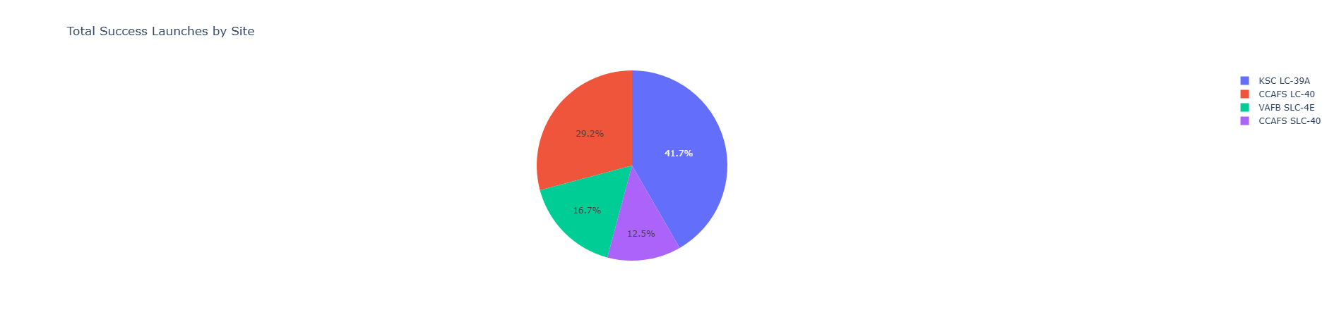
SpaceX Falcon9 Dashboard
The image shows the success rate launches from all the launch sites.
KSC LC-39A has the most success rate
CCAFS SLC-40 has the least success rate.

Slide 41
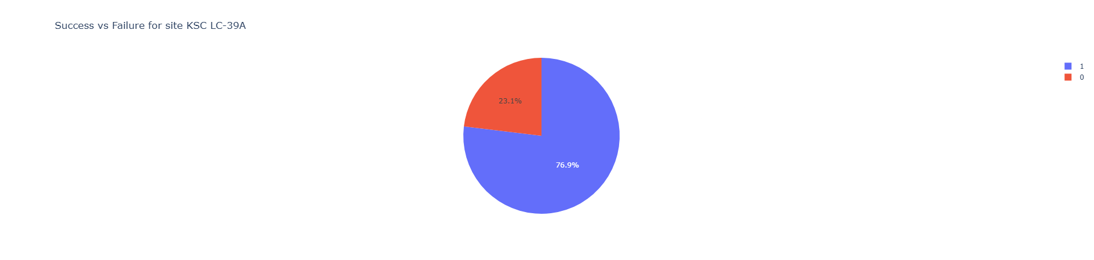
KSC LC-39A Launch Site
KSC LC-39A Launch Site has the highest success rate among the other launch sites having 77% success rate in the mission from this launch site.

Slide 42
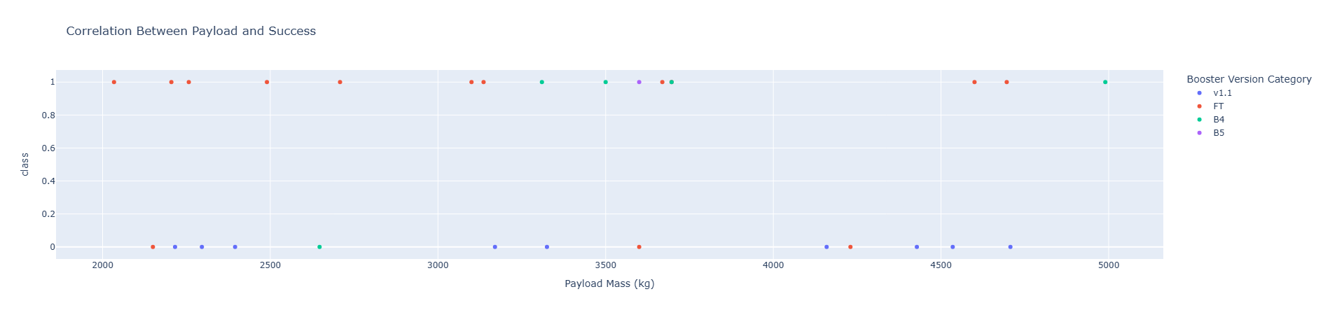

Booster to Payload Relationship
The first graph is for the payload 2000 to 5000.
The second graph is for the payload 1500 to 5500

Slide 43

Section 5

Slide 44
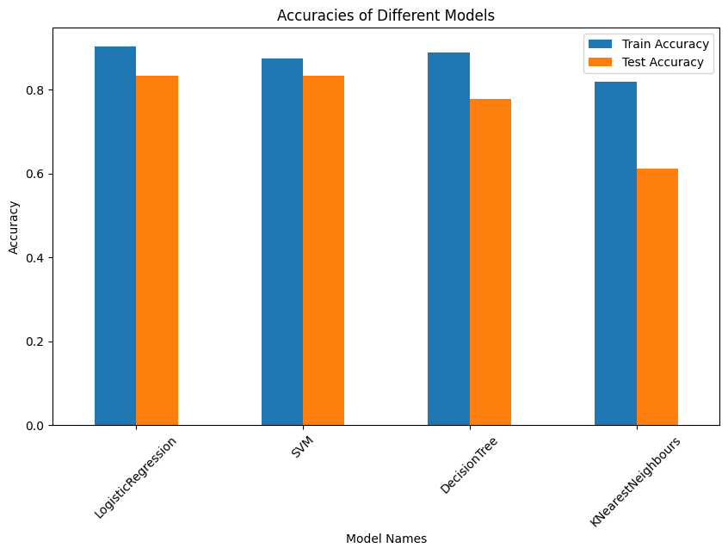
Classification Accuracy
Logistic Regressions model has the highest train and test accuracies

Slide 45

Confusion Matrix
This is the confusion matrix on test set of Logistic Regression model
This shows that TP are 12, TN are 3, FP are 0, FN are 3
There is type-2 error. This is the only this which is stopping model to be perfect

Slide 46

Confusion Matrix
This is the confusion matrix on train set of Logistic Regression model
This shows that TP are 46, TN are 19, FP are 2, FN are 5
There are type-1 and type-2 errors.

Slide 47
Conclusions
Logistic Regression is the best model to be used to predict the First landing of a SpaceX Falcon 9 spacecraft.
By this info we can estimate the cost of the mission. As the prediction of “First Landing” is the initial step for estimation.

Slide 48
Appendix

Slide 49


